Slide 1
Community Environmental Monitoring Program (CEMP) ⎯ Administered & Operated by DRI for the U.S. Department of Energy, National Nuclear Security Administration, Nevada Site Office (USDOE/NNSA/NSO) ⎯ WORKSHOP held July 24 to 28, 2011, at Cedar Breals Lodge in Brian Head, UT
Risk: What is it and how does the public interpret it?
A Presentation in the “Radiation Training” Session held on Monday, 25 July 2011, at Cedar Breaks Lodge, in Brian Head, Utah, of the CEMP Workshop (July 24 to 28, 2011) ⎯ The CEMP: Past, Present, and Future
by
Jeffrey I. Daniels, D.Env.
Associate Research Professor for Health Science
Division of Hydrologic Sciences at DRI (SNSC)
Las Vegas, NV
jidaniels@dri.edu / 702-862-5453

Slide 2
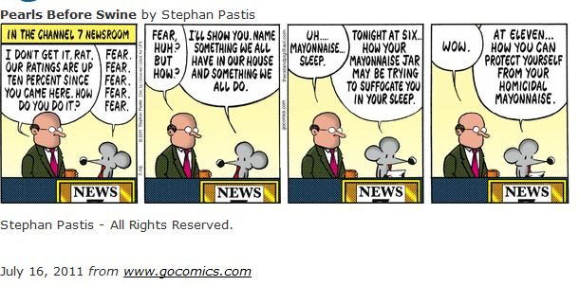
What determines risk? (e.g., #1)
THE NEWS

Slide 3
What determines risk? (e.g., #2)
OBSERVATION
A sportsman riding through a town sees a barn wall covered with 100 targets, every one of which has an arrow through the center.
“Who is this sharpshooter?” the inquisitive sportsman asks a townsperson.
The townsman’s reply “ … the town fool. You see, this individual shoots the arrow and then paints the target. I could take you to him?”
Moral: Not all the information is available immediately for making a clear judgment about a situation or a person.
Note: Life in real time is complex, and composed of bits of information, most often revealed slowly.

Slide 4
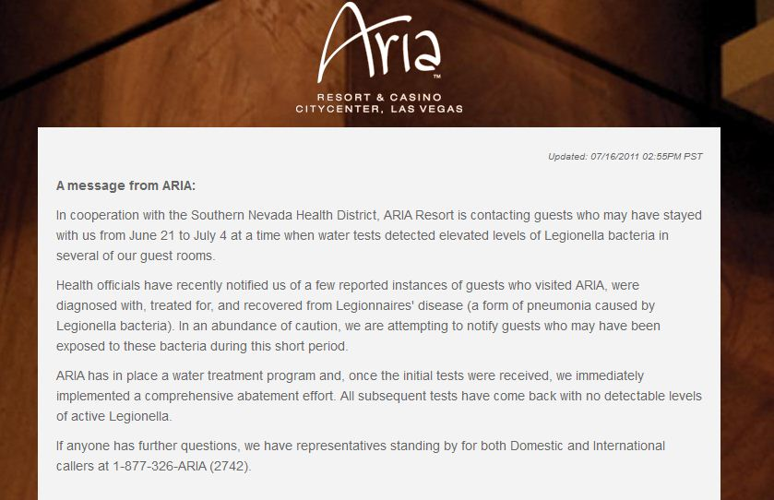
What determines risk? (e.g., #3)
Full Disclosure
Full Disclosure
http://www.arialasvegas.com/facts/
Comment from the blogosphere: Would you stay at the Aria and risk exposure to Legionnaire's Disease? Talk about taking a gamble ...
http://news.gather.com/viewArticle.action?articleId=281474979672194

Slide 5
What determines risk? (e.g., #4)
THEORY
July 1942, Oppenheimer convened theoretical physicists and experimental physicists who tentatively confirmed that a fission bomb was theoretically possible.
Edward Teller raised the speculative possibility that an atomic bomb might "ignite" the atmosphere because of a hypothetical fusion reaction of nitrogen nuclei.
Hans Bethe calculated that it could not happen, and a report co-authored by Teller showed that "no self-propagating chain of nuclear reactions is likely to be started.” In author Robert Serber's account, Oppenheimer mentioned it to Arthur Compton, who "didn't have enough sense to shut up about it. It somehow got into a document that went to Washington," which led to the question being "never laid to rest” …
up to when, as Hans Bethe recalled in 1991, “ … the worry was not entirely extinguished in some people’s minds until the Trinity test.”
The Manhattan Project yields
revolutionary new weapon;
the development of the network of national laboratories;
support for medical research into radiology; and
the foundations for the nuclear navy
From http://en.wikipedia.org/wiki/Manhattan_Project

Slide 6
“Community decisions” are the aggregate of individual ones
Choices are based on interpretation of information:
Reasonable understanding about uncertainty and probability
For example, informed judgment from calculated risk about actions or inactions
Perception that can be influenced by the nature and timing of communication:
For example, “observations” reported first or second hand about outcomes of events, and actions or inactions (and who is doing reporting)

Slide 7
Risk acceptance
To some degree, a modern society has risk “built into its collective DNA” in order for it to achieve the rewards of progress, advancing technically and industrially, where
Risk = likelihood that an undesirable outcome will result from a chosen action;
Undesirable outcome = public-health (and/or occupational) injury; and
Chosen action = transforming of understanding into a publicly approved responsible practice generally by informed consent

Slide 8
Food-Borne Illness
Food Contamination does occur
Crop to kitchen
Food is not from centralized location 48,000,000 get sick each year (≈ 16% of U.S.) from contaminated food
Example: Salmonella most common infection (% cases)
29% from Poultry
20% from fish, sprouts, leafy greens, dairy …
18% from eggs
20% from pork (12%) and beef (8%)
13% remainder (fruits, nuts, vine vegetables)
Risk Reducing measures:
Washing hands
Separate raw meat, fish, and poultry
Cook thoroughly

Slide 9
Outbreak in Europe (May 2011)
Rare E. coli infection (strain O104; shiga-toxin like); can survive for days or weeks
Normal reservoir = ruminant (cattle, but also goat, sheep, bison, or elk)
But resembles enteropathogenic (strain O157)
Normal reservoir = human
794 cases of hemolytic uremic syndrome with 22 deaths (2.8% of infected or 1/35 chance) from O157
Risk of getting sick estimated as 3% (1/30) for 1 cell; 10% for 100 cells (1/10 chance)
Most infected do get better
US Risk 1/100,000 annually (5 to 6 cases/y in Las Vegas)
Eating sprouts from Germany can be risky
Solution don’t bring to market

Slide 10
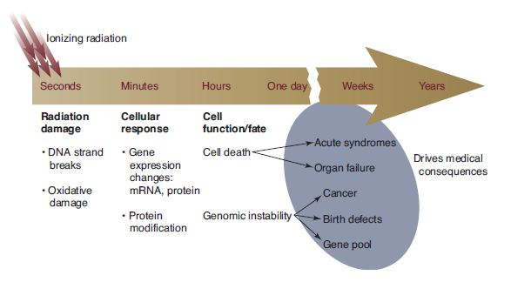
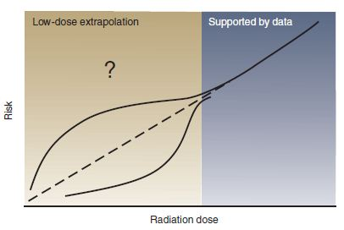
Radiation effects
Background lifetime risk of dying from cancer in U.S. is 23 % (male) and 20% (female ) according to American Cancer Society, for data from 2005-2007 http://www.cancer.org/Cancer/CancerBasics/lifetime-probability-of-developing-or-dying-from-cancer
Figures are from Wyrobek (2003), “Cells Respond Uniquely to Low-Dose Ionizing Radiation,” in Science & Technology Review (ST&R), a publication of the Lawrence Livermore National Laboratory, Livermore, CA, UCRL-52000-03-7/8 (July/August 2003 issue); https://www.llnl.gov/str/JulAug03/Wyrobek.html

Slide 11
Exposure and Detection
Exposure is contact with media (air, water, soil, vegetation, animal products)
Transport to and in media is a function of event and chemistry (gas, solid, liquid)
Emissions of ionizing radiation and existence (t_{½})
Alpha (α)
Beta (β)
Gamma (γ)
Signatures of nuclear reactions and spectra of specific isotopes
fission products (I-131; Cs-137; noble gas)
fuels (uranium)

Slide 12
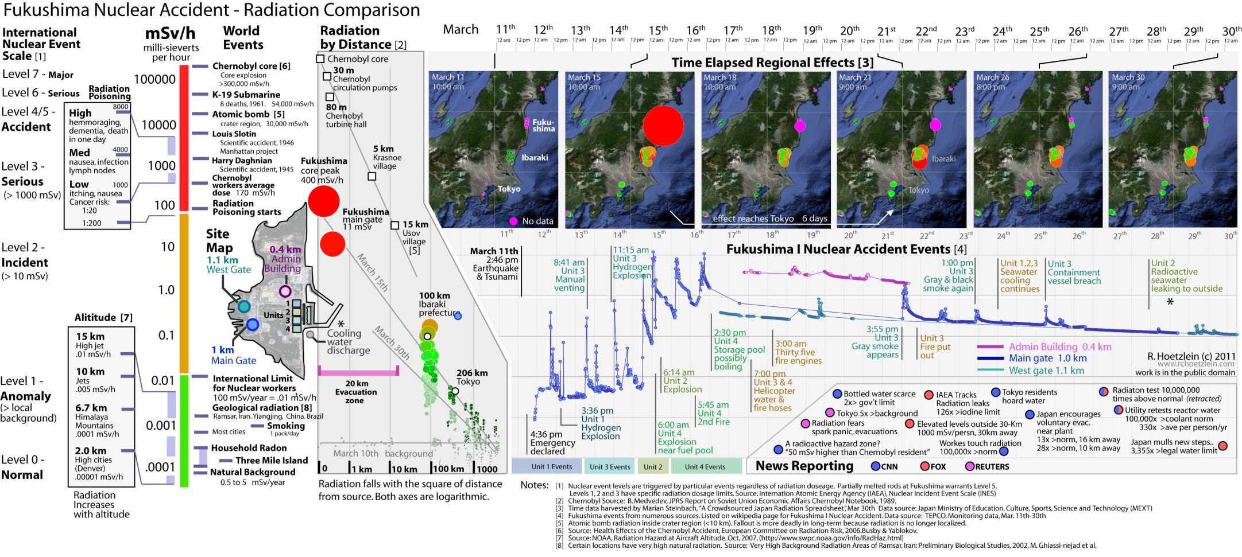
Fukushima events and comparisons (March 2011)
http://www.rchoetzlein.com/theory/2011/fukushima-radiation-comparison-map/
Solution: Advise and consent to limit exposures

Slide 13
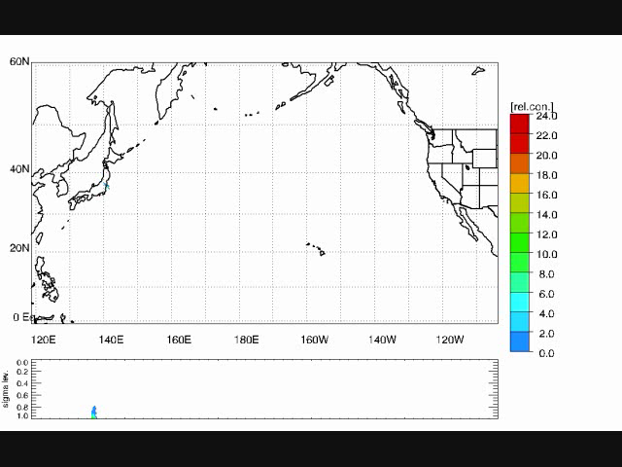
Radionuclide dispersion from Fukushima NPP Incident
March 12, 2011 through March 18, 2011
Plume location
March 13, 2011
March 16, 2011
March 18, 2011
Courtesy of Meija, J., and D. Koracin , “Numerical Weather Predicition and Lagrangian Dispersion Model: Radiation Plume from Japan’s Fukushima Nuclear Reactors Explosion,” DAS at DRI, Reno, NV.

Slide 14
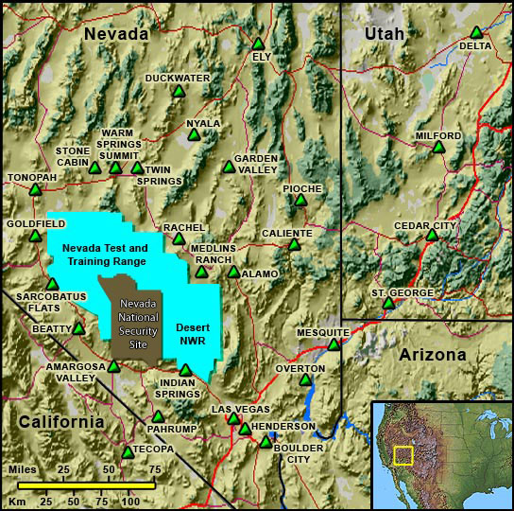
CEMP Monitoring
Henderson (I-131):
23-25 MAR_{max} 1 × 10⁻³ pCi/L
01-04 APR_{min} 3 × 10⁻⁵ pCi/L
Las Vegas (I-131):
23-25 MAR_{max} 1 × 10⁻³ pCi/L
01-04 APR_{min} 3 × 10⁻⁵ pCi/L
Trace quantities of I-131 detected on paper filters only at
Boulder City
Henderson
Las Vegas
Duckwater
Pahrump
Amaragosa
Garden Valley
St. George
Solution: Limited exposure, no measurable consequence likely, virtually no risk, advise to take no actions

Slide 15
Conclusions
Interpretation of risk can be a function of
Knowledge (education) or
Beliefs (culture) or
Strict adherence to a zero-tolerance precautionary rule (safety) or
Adrenalin
Informed decisions about responsible action or inaction are based on knowledge; understanding data; and a qualitative grasp of uncertainty in the moment
Personal
Professional (authorities or scholarly)
Observational (multiple sources)

