Slide 1
FUKISHIMA Nuclear Reactors
Radiological Assessment
Air Measurement Surveillance
AMS
March 22, 2011

Slide 2
AMS Summary
Operations Summary
  Aerial Measurement Systems totaled more than 40 hours of flights
Plot interpretation
  AMS data presented as exposure rate
  1 meter above ground at time of measurement

Slide 3
Guide to Interpretation
US radiological assessments composed of aerial and ground measurements and indicate amounts of radiological material settled on ground.
Each measurement corresponds to radiation person receives in 1 hour at that location.
Calculations account for multiple variables. Radiation is most intense in first days after release. Dose reduction achieved by evacuating early
All measurements below 0.03 Rem per hour – a low level.
Most elevated readings within 25 miles of Fukushima Daiichi.
Measurements show area of higher radiation extending northwest from Plants.

Slide 4
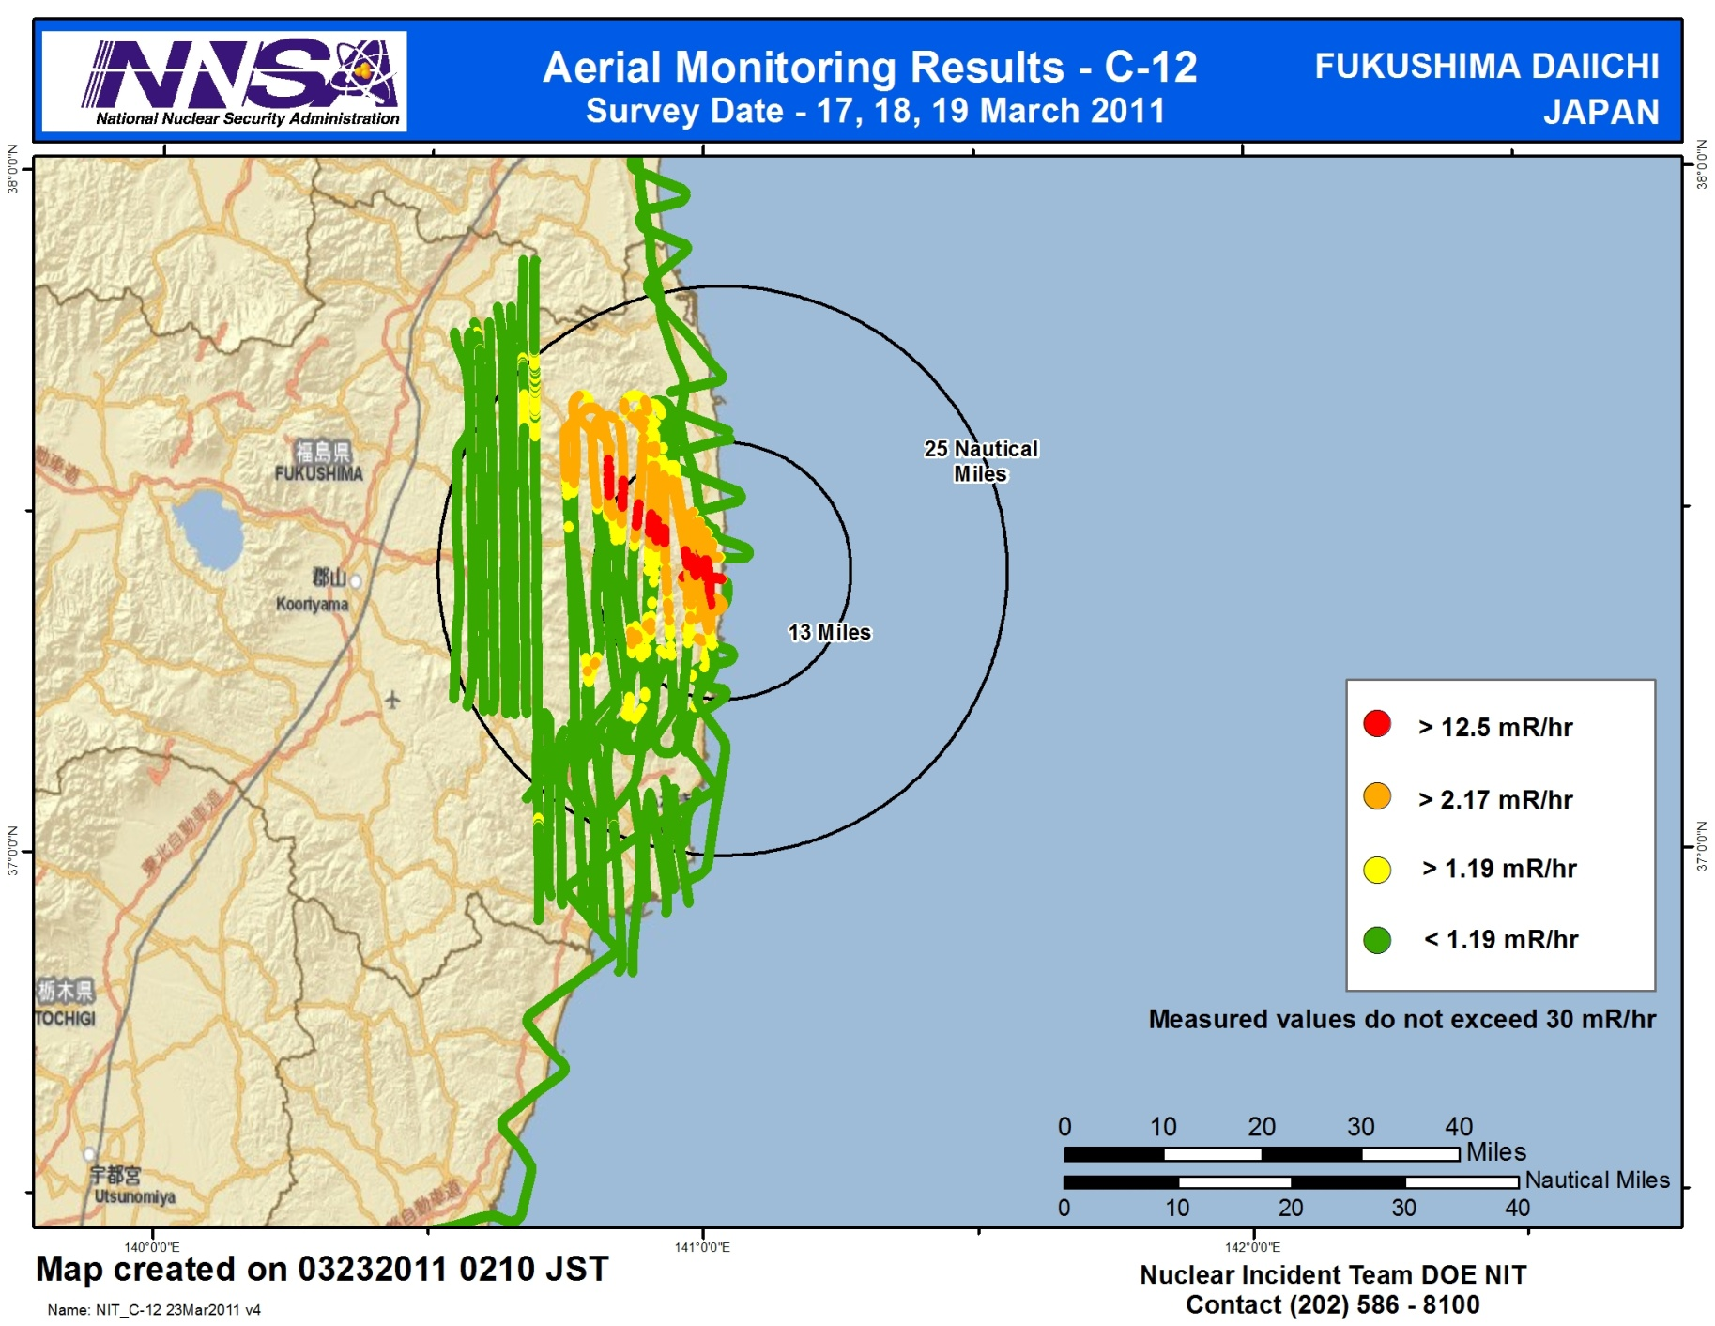

Slide 5
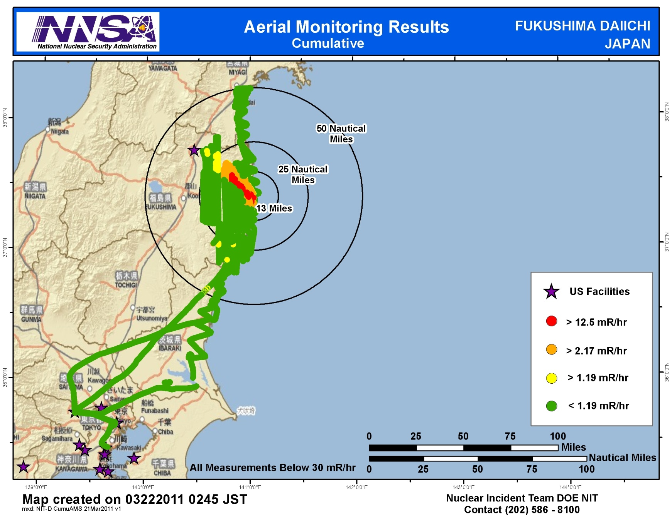

Slide 6
Comparison
Nuclear Regulatory Commission (NCRP) estimates average
US person receives 620 mRem a year* (or 0.071 mRem/hour)
Average transatlantic flight gives exposure of 2.5 mRem*
Typical chest x-ray produces 10 mRem per image
EPA guidelines for public health actions if exposure >1000 mRem over 4 days
  * Source: NRC: http://nrc.gov/images/about-nrc/radiation/factoid2-lrg.gif
6

Slide 7
