Slide 1
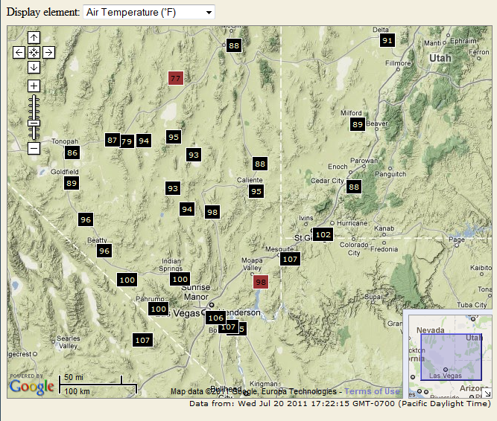
Community Environmental Monitoring
Program (CEMP) Annual Workshop
Welcome & DRI Overview
Terry Surles, DRI
26 July 2011

Slide 2
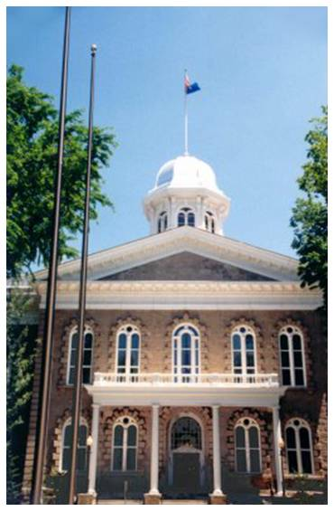
DRI Established 1959
Nevada Legislature created a division within the system of higher education devoted to research and mandated to:
  Promote general welfare of State of NV and its citizens
  Conduct and promote fundamental & applied research
  Encourage faculty and student research
  Acquire and disseminate knowledge

Slide 3

Nevada System of Higher Education (NSHE)
Board of Regents
Chancellor
System Office
Universities
Community Colleges
State College
Research Institute
UNLV
UNR
CSN
GBC
TMCC
WNC
Nevada State College
DRI

Slide 4

Economic Leveraging
DRI’s total revenue about $54 million, yet DRI accounts for only 1.1% of higher education’s budget
2000-2010, DRI has leveraged $71M (State operating budgets, excludes State capital budgets) funding to attract $351M in external research
NSHE Budget
FY10

Slide 5
DRI Is Extremely Effective in Generating New Funding with Modest State Resources
5
  DRI generated $45.5 M in out of state revenue in FY2010.
  Revenues for FY 2010 from all sources (including State appropriations) was $54.6 M.
DRI – Science. Environment. Solutions.
7/26/11

Slide 6
DRI: Superior Research Is by Statute One of Necessity and Design
6
Three-dimensional image of air flow
Outstanding faculty (currently 140) MUST remain competitive due to lack of tenure
Culture of collaboration and collegiality
Financial model supports proposal development and service for soft-funded faculty
Reputation is based on scientific excellence coupled with track record for being on time and within budget
Photo by John A. Benson, courtesy of SGI
DRI – Science. Environment. Solutions.
7/26/11

Slide 7

DRI’s Competitiveness
Ranking by R&D expenditures in Environmental Sciences at universities & colleges (NSF Statistics, FY 2009)
    1 University of California - San Diego (includes Scripps)
    2 Texas A&M University
    3 Colorado State University
    4 Woods Hole Oceanographic Institute
    13 The Johns Hopkins University
    18 University of Maryland Center for Environmental Sciences
    23 DRI
    28 University of California - Davis
    36 Stanford University
    37 Harvard University
    45 University of Southern California
    40 University of Nevada, Reno
    70 University of Nevada, Las Vegas

Slide 8
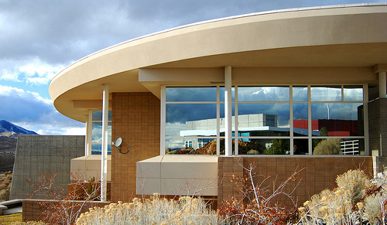
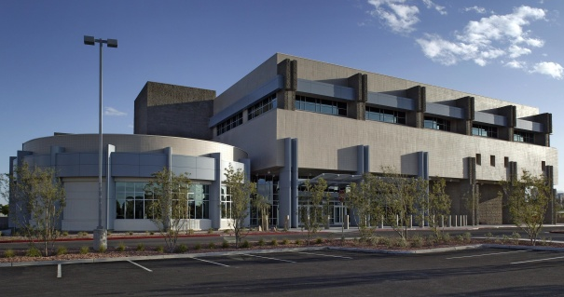
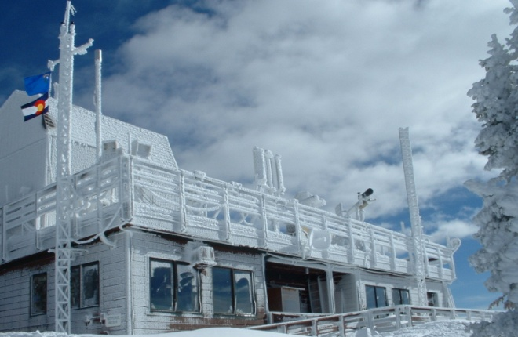
Campuses and Facilities
Today, DRI has two primary campuses:
  Reno
  Las Vegas
with research facilities in:
  Boulder City
  Steamboat Springs, CO
  Stead
Northern Nevada Science Center - Reno
Southern Nevada Science Center – Las Vegas
Storm Peak Laboratory –
Steamboat Springs Colorado

Slide 9
DRI’s Multi-Disciplinary Projects Are Financially Strong Activities
9
DRI Divisions
  Division of Hydrological Sciences - $12.6M
  Division of Earth and Ecosystem Sciences - $11.1M
  Division of Atmospheric Sciences - $13.2M
DRI Centers
  Clean Energy and Renewable Technology Center
  Center for Watershed Environmental Sustainability
  Center for Environmental Remediation and Monitoring
  Center for Advanced Visualization, Computation, and Modeling
DRI – Science. Environment. Solutions.
7/26/11

Slide 10

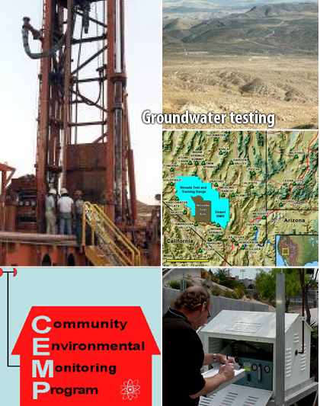

Research Benefiting Nevada
DRI’s groundwater flow model approved for use at the Shoal underground nuclear test site near Fallon, Nevada.
Community Environmental Monitoring Program monitors for radiation in the region surrounding the Nevada Test Site.

Slide 11
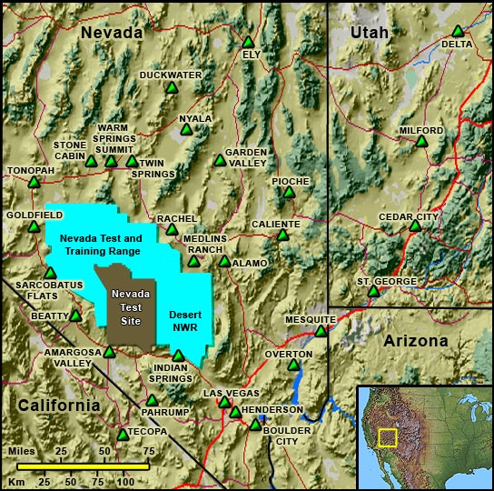
Rogers Center for Environmental Remediation and Monitoring
Evaluating human health and risks from contaminants
Fostering long-term stewardship of contaminated or waste disposal sites
Developing new methods for environmental monitoring and remediation
Involving citizens in data collection and decision-making for environmental management
CEMP monitoring stations in Nevada, Utah, and California

Slide 12
Concern for Nevada Is Water/Energy Nexus
Notes:
Challenge is that given the diversity of industrial segments and sensitivity to energy costs and issues, where do we focus?
We analyze energy use.
We isolated segments that are the biggest users of electricity. Focus on them based on energy use, economic and environmental impact and system wide energy use analysis.

Slide 13
As Much Freshwater Is Used For Producing Electricity As For Irrigation
Source: USGS Circular 1268, March, 2004
Notes:
A lot of different of different sectors of society compete for that <1%.
Not all energy requirements, only that withdrawn for thermoelcectirc cooling purposes
Slide illustrates withdrawal,not consumption.
In terms of water consumed (evaporated or transpired) 4% of cooling water evaporated, vs. 60% of irrigated water evapotransporated.
Key issue that in order to site facilities or produce electricity, the water has to be available to be withdrawn.
What people find surprising is this gray piece of the pie. That’s water withdrawn for thermo-electric power production, which is primarily fossil and nuclear and a tiny amount of geothermal. It’s second only to agriculture in water use (in the East it’s first).
This is ONLY electricity production; it does not include the entire energy cycle—such as fuel mining, refining, transport (e.g., slurry pipeline) which also impact water quantity and quality
This does NOT include hydroelectric. Has it’s own set of issues like evaporative loss from dammed rivers, but it will probably decline or be converted to in-stream process in the future.
This does NOT include saline water used for cooling
Total freshwater use 346 Bgal/day, thermoelectric 136 Bg/day, irrigation 137 Bg/day (USGS circular 1268, 2004)
` 4% of energy use “consumed, 60% of irrigation “consumed”
Link to consumption slide

Slide 14
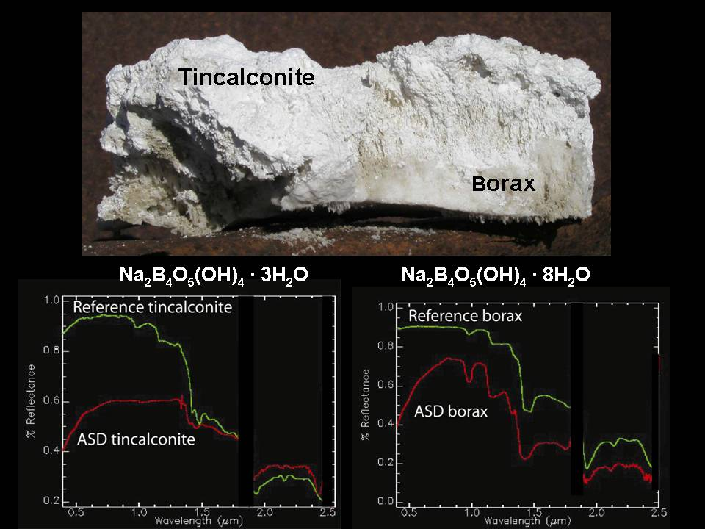
Hyperspectral Imaging - Strong relationship between high boron concentrations and geothermal fluids

Slide 15
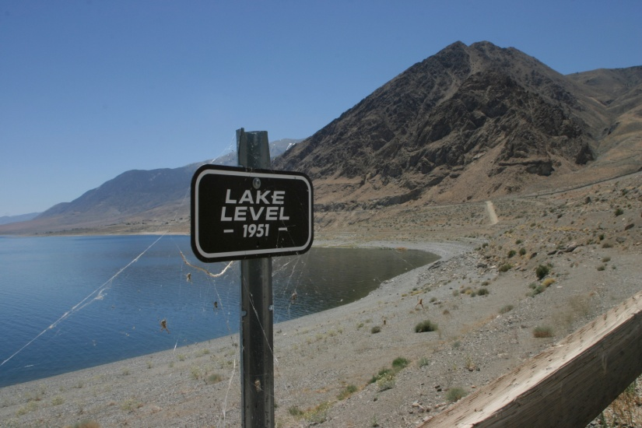
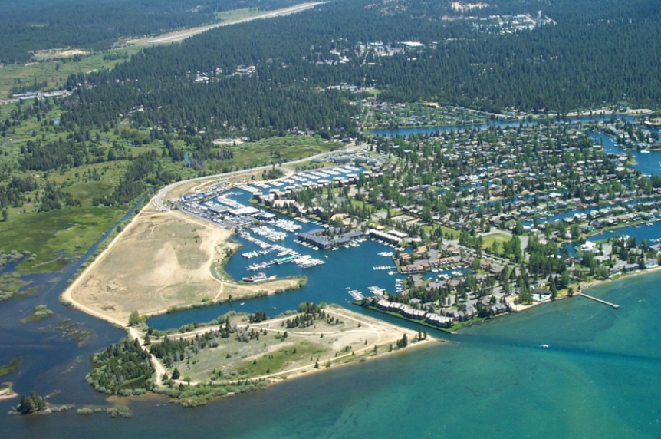
Center for Watershed Environmental Sustainability: Goals
Develop interdisciplinary research programs to provide scientific information to decision makers for Walker Lake Basin
Develop interdisciplinary research programs to provide scientific information to decision makers in the Lake Tahoe Basin
  Works with UNR and UC/Davis for as part of the Tahoe Science Consortium

Slide 16
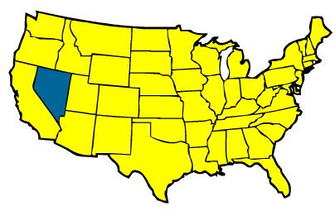
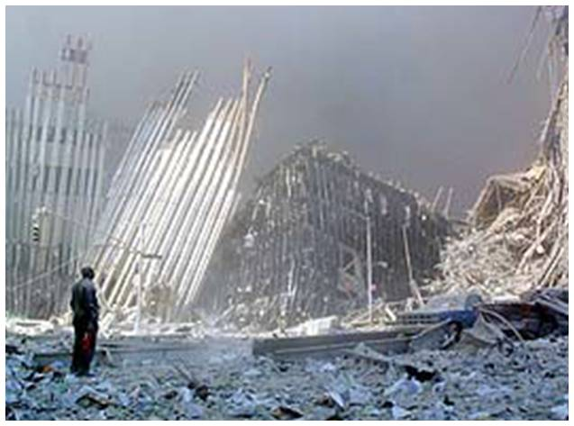
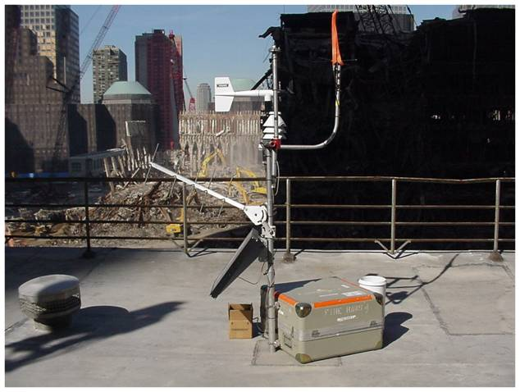
Research Benefiting the Nation
DRI’s Western Regional Climate Center contracted by FEMA in aftermath of World Trade Center attacks on 9/11
DRI contacted to create a Web site providing public access to atmospheric conditions
Web site up and operating within two days of initial request!

Slide 17
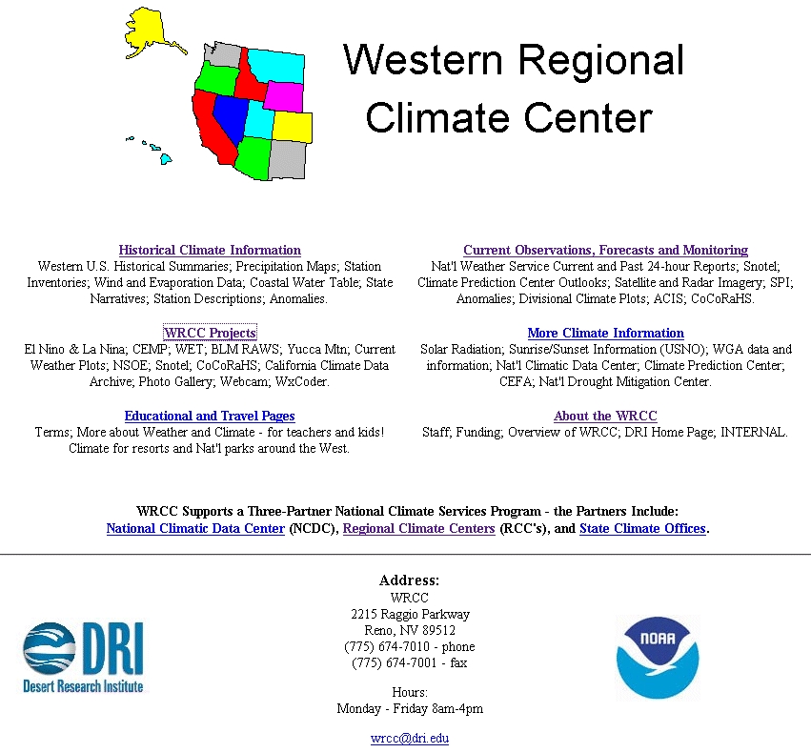

Western Regional Climate Center
17
DRI – Science. Environment. Solutions.
7/26/11
Notes:
17
Daily concentration fluctuations: Hg⁰, CO, O₃, aerosols, humidity
Daytime BL air versus cleaner, nighttime air masses

Slide 18
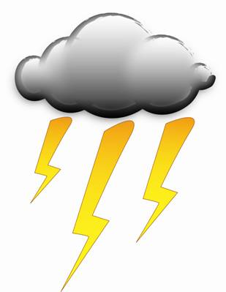




WRCC Practical Research Issue: Climate Change Related to Fire and Ecosystems
18
Vegetation
Wildfire
DRI – Science. Environment. Solutions.
7/26/11
Notes:
Air Quality and Air Pollutants
Characterizing & quantifying: inorganic and organic aerosols, carbon fractions
Air Pollution and Meteorology
Emission Source Contributions and Inventories
Atmospheric Processes
Ice physics
Cloud Physics
Cloud Microphysics
Fluxes of Particles and Gases (e.g., mineral dust, Hg)
Radiative Forcings (aerosol and cloud optical properties)
Instrument Design (to measure key properties)
Modeling of the Atmosphere:
Meteorology and mesoscale weather prediction
Regional, mesoscale, &microscale atmospheric and dispersion modeling
Energy
Clean Technologies and Renewable Energy Systems
Energy Management/Energy Efficiency
Climate/ Climatology:
Data analysis & scientific visualization
Regional Climate change & variability
Weather Modification
Ground-based and airborne cloud seeding
Fire
Fire-meteorology, fire-climate relationships
18

Slide 19
Projects in Support of National Security
  Military Geosciences
    Global Military Operating Environments: Linking Natural Environments, International Security, and Military Operations
    GMOE II: Focus on Afghanistan and SW Asia
    Reconstructing Landscape History and Paleo-environments at Naval Air Weapons Station China Lake
  Cultural Resources on Military Lands
    Yuma Proving Ground Cultural Resources
    Cooperative Agreement between US Army Environmental Center and DRI for Cultural Resources Services (Dugway)
  Cold War Historic Preservation/Nevada Test Site

Slide 20

Center for Advanced Visualization, Computation, and Modeling (CAVCaM)
Data Collection, Analysis, and Modeling Must Be Linked
Deepwater Horizon modeling software showed BP cement conditions were unstable

Slide 21
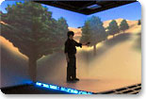
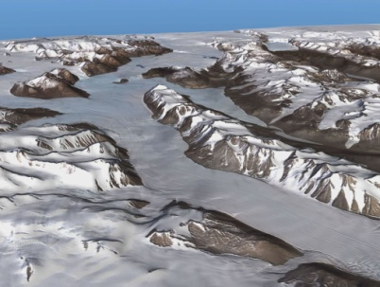
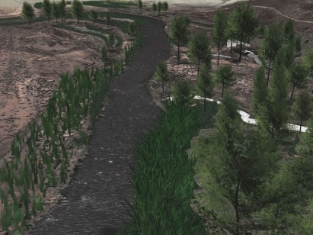
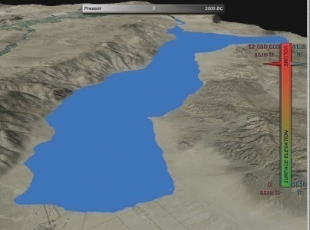
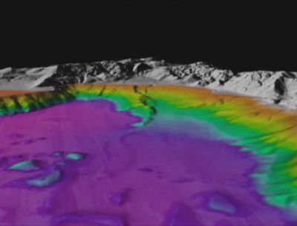
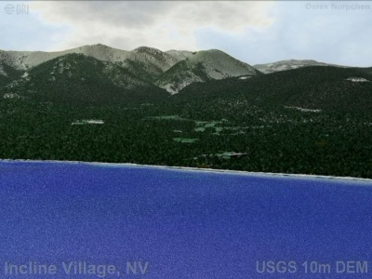
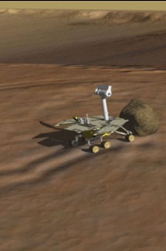
Fully Immersive Virtual Reality Environment: CAVE - Enhancing Private Sector Funding
CAVE = Cave Automatic Virtual Environment
Name inspired by Plato’s allegory of the cave

Slide 22

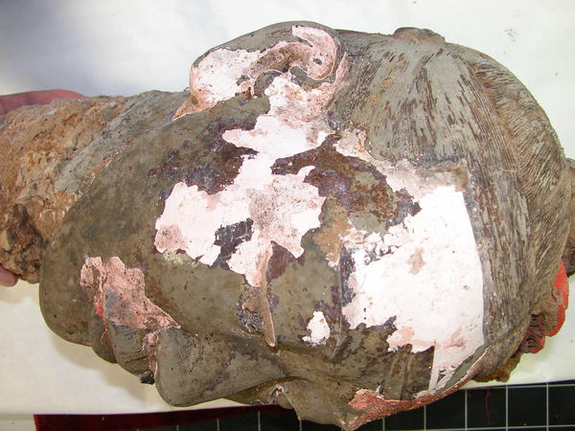
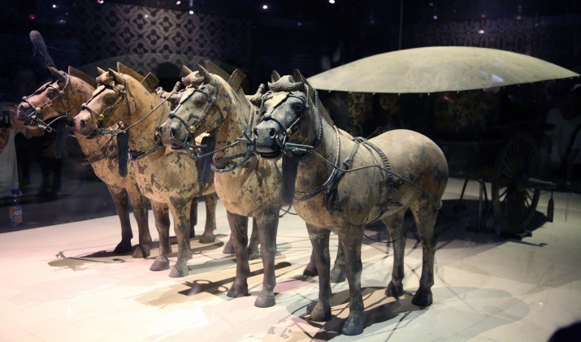
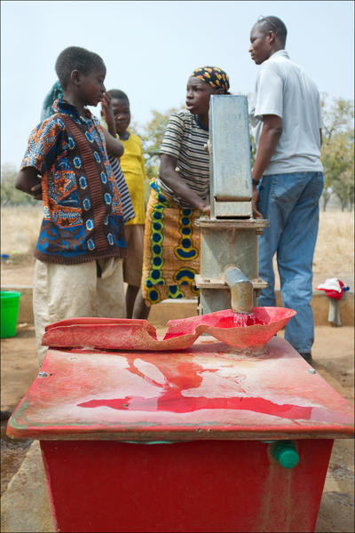
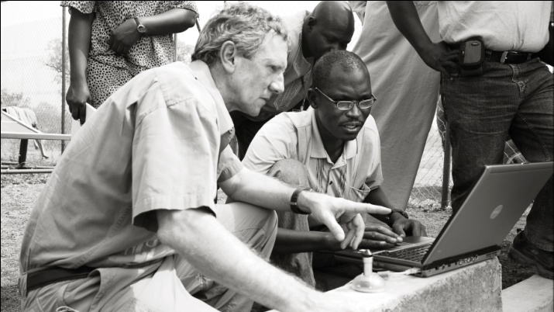
Research Benefiting the World
Impacts of air quality on China’s national treasures with CAS IEE
West Africa Water Initiative with Hilton Foundation

Slide 23
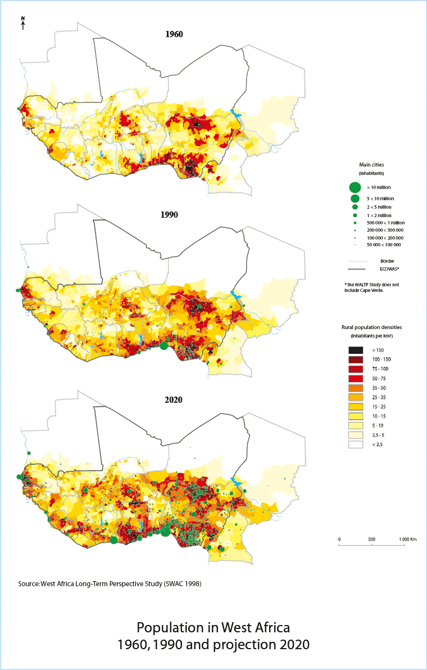
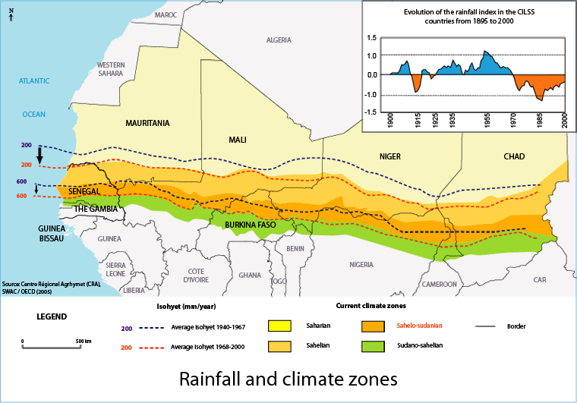
Why Sustainability - Issues Go Beyond Health
Meet increasing demand
Evaluate ongoing supply - Decrease of rainfall / desertification
http://www.atlas-ouestafrique.org
http://www.atlas-ouestafrique.org
Notes:
23

Slide 24
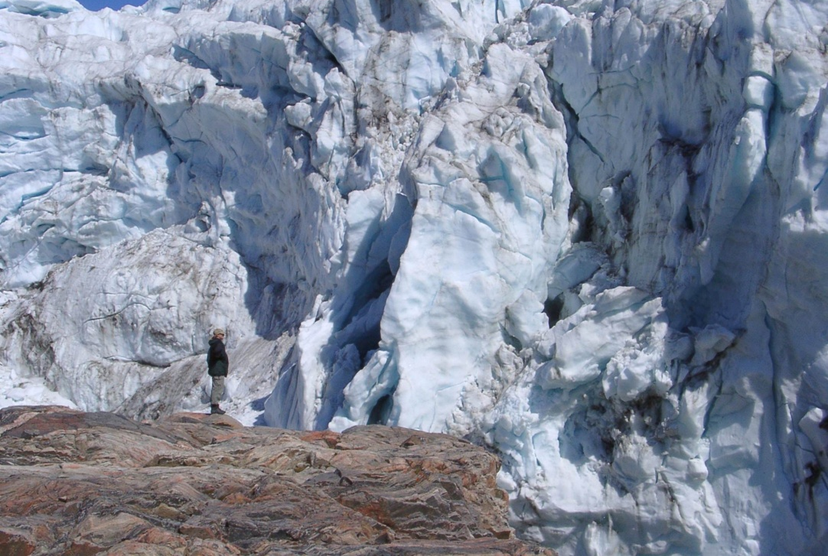
Joe McConnell Leads a Highly Complimented Project on Trace Element Deposition in Greenland
24
Apply innovative methods for continuous, high-resolution ice-core analyses called Continuous Flow Analysis with Trace Elements (CFA-TE)
Develop multi-century glacio-chemical records of trace elements and isotopes with unprecedented temporal resolution
Work has recently expanded to include analysis of black carbon
Notes:
24
DHS is also involved with a variety of environmental assessment projects.
Project west-central Greenland
determine trace element and isotope conc in ice core
using unique high-resolution analysis methodology
Use glaciochemical data to study environmental and global change issues

Slide 25
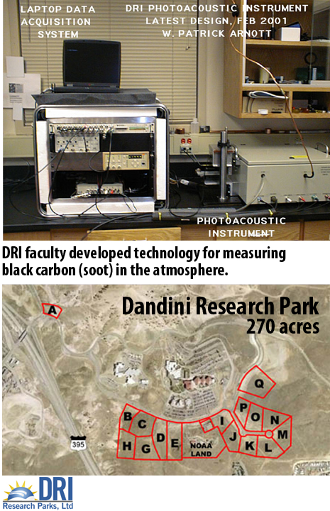
Strategic Partnering with Businesses & Technology Transfer
2004-10 Technology:
  47 invention disclosures
  26 patents issued
  5 license agreements
Areas of Partnership
  DRI and UNR Tech Transfer Office
Dandini Research Park
  Clean Energy,
  Environmental Sciences,
  Life Sciences, and
  Visualization & Information Technology

Slide 26
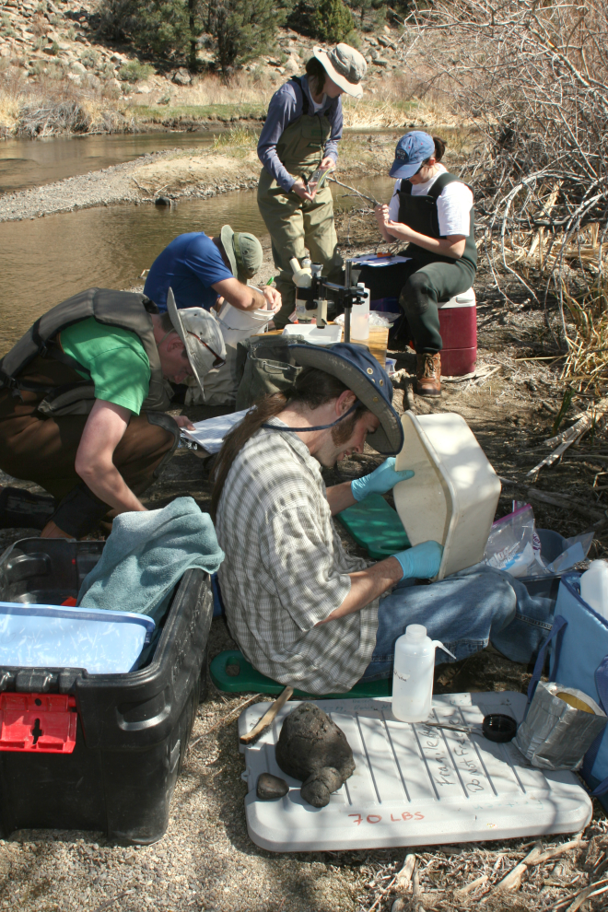
DRI’s Value Added to Education
UNR:
  Atmospheric Sciences
  Hydrologic Sciences
  Other (anthropology, geo., bio., eng. etc.)
UNLV:
  Water Resource Management
  Other (anthropology, bio., chem., eng., environmental studies, geo., etc.)
Nevada State College
Key Points:
Approximately 50 faculty teaching and advising students at present
There are 55-65 students supported at DRI
DRI invests ~ $1.7 M/year (non-State funds) for support of grad students at UNLV and UNR

Slide 27
Why Is DRI Expertise Important: Energy/Environmental Problem Confluence
Critical need to make best use possible of indigenous national resources
  Water in the Southwest
  Energy resources in the region and nation
Energy resource competition will require effective environmental development and use of national resources
  Geothermal, solar, wind, coal, uranium
Climate change can produce “winners” as well as “losers” - requires an understanding of past climate events and the impact on cultures
  Northern countries may benefit: Canada, Russia
  Temperate countries may suffer due to loss of cropland and increase of tropical diseases and exotic pests
  Winners and losers will also be driven by water - more severe storms, more persistent droughts, and wildfire
Exacerbate international tensions - reason for interest in DRI
  Particularly issues of water availability: China, Middle East, Africa

Slide 28
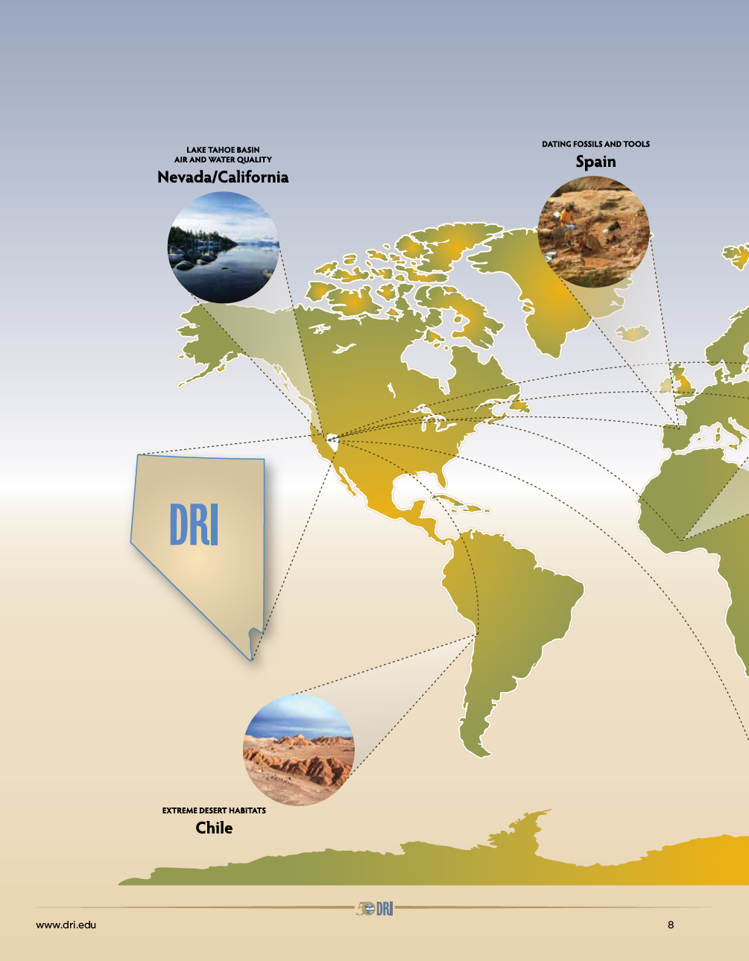

DRI: Bringing Global Recognition to Nevada
28
DRI – Science. Environment. Solutions.
7/26/11
Notes:
28

